Slide 1
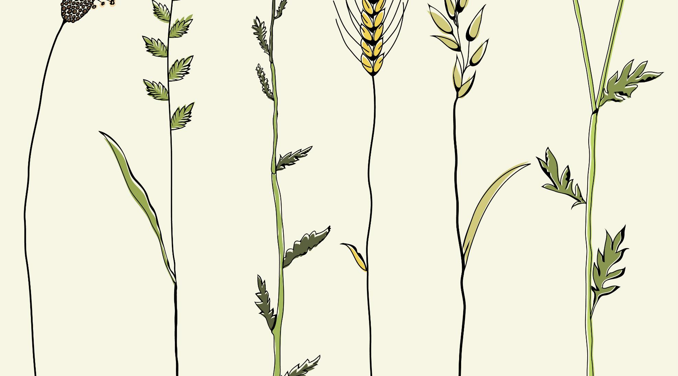
The Ethics and Economics of Environmental Protection
2. Risk, Ethics, and the Precautionary Principle

Slide 2
1. The limits debate, again
The limits debate reflects different interpretations of the relationship between economic progress and environmental change
Malthusians argue that breaching the Earth’s carrying capacity threatens the eco-system and human well-being
Humans are dependent on a system of ecological goods and services that are external to, and greater and more complex than, human processes
Prometheans argue that economic growth facilitates both a higher standard of living and an expanded supply of goods and resources
Human ingenuity allows for increasingly efficient combinations of labour and resources which provide ever better defences against threats (natural or human-induced)
Reasons and risks
This debate reflects opposing attitudes to the nature of the risk we face, and how that risk ought to be distributed
More simply: what form and level of risk is reasonable, i.e., socially and morally acceptable?

Slide 3
Two examples
Challenges to wildlife
Climate change both harms living animals and plants, and changes which will, over time, come into existence
E.g., polar bears live harder, shorter lives than they would have done without climate change
The question is: are the likely harms felt by wildlife acceptable given the benefits to people? Does it matter that evolution forces fairly swift adaptations among flora and fauna?
The “world-system”
Climate change is part of a wider set of social and economic developments that link environmental outcomes to human behaviour in apparently systemic ways
E.g., environmental degradation may be linked to increasing disparities of wealth, the rise in migration (and associated social tensions), and even a tendency to authoritarianism
The question is: are the apparent problems with global capitalism concrete and significant enough to warrant a wholescale shift in social organisation? Does it matter that the prospects of such a shift—or, at least, of keeping control over it, are poor?
Notes:
E.g. 1: relates to the biocentric approach. 2 relates to human itilityIs climate change only a problem when it causes harm to people?
Is climate change only a problem when it causes harm to people?

Slide 4
Values and risks
Collectivism
High degree of social control
Low degree of social control
Individualism
Attitudes to risk and change
Changes wrought by individuals are generally bad (i.e., worse than alternative options)
Changes wrought by individuals are generally good (i.e., better than alternative options)
The harms to wildlife of unregulated change are unethical and inappropriate;
Despite its benefits, unregulated economic and social change are too dangerous to be left alone.
The harms to wildlife of unregulated change cannot be judged holistically;
Despite its benefits, centrally directed changes are liable to cause more harm than good.
Notes:
We’re not always in the same place on all issues (consider Marx. Individuals make poor choices unless free) Things are complicated; remember that this is an heuristic.

Slide 5
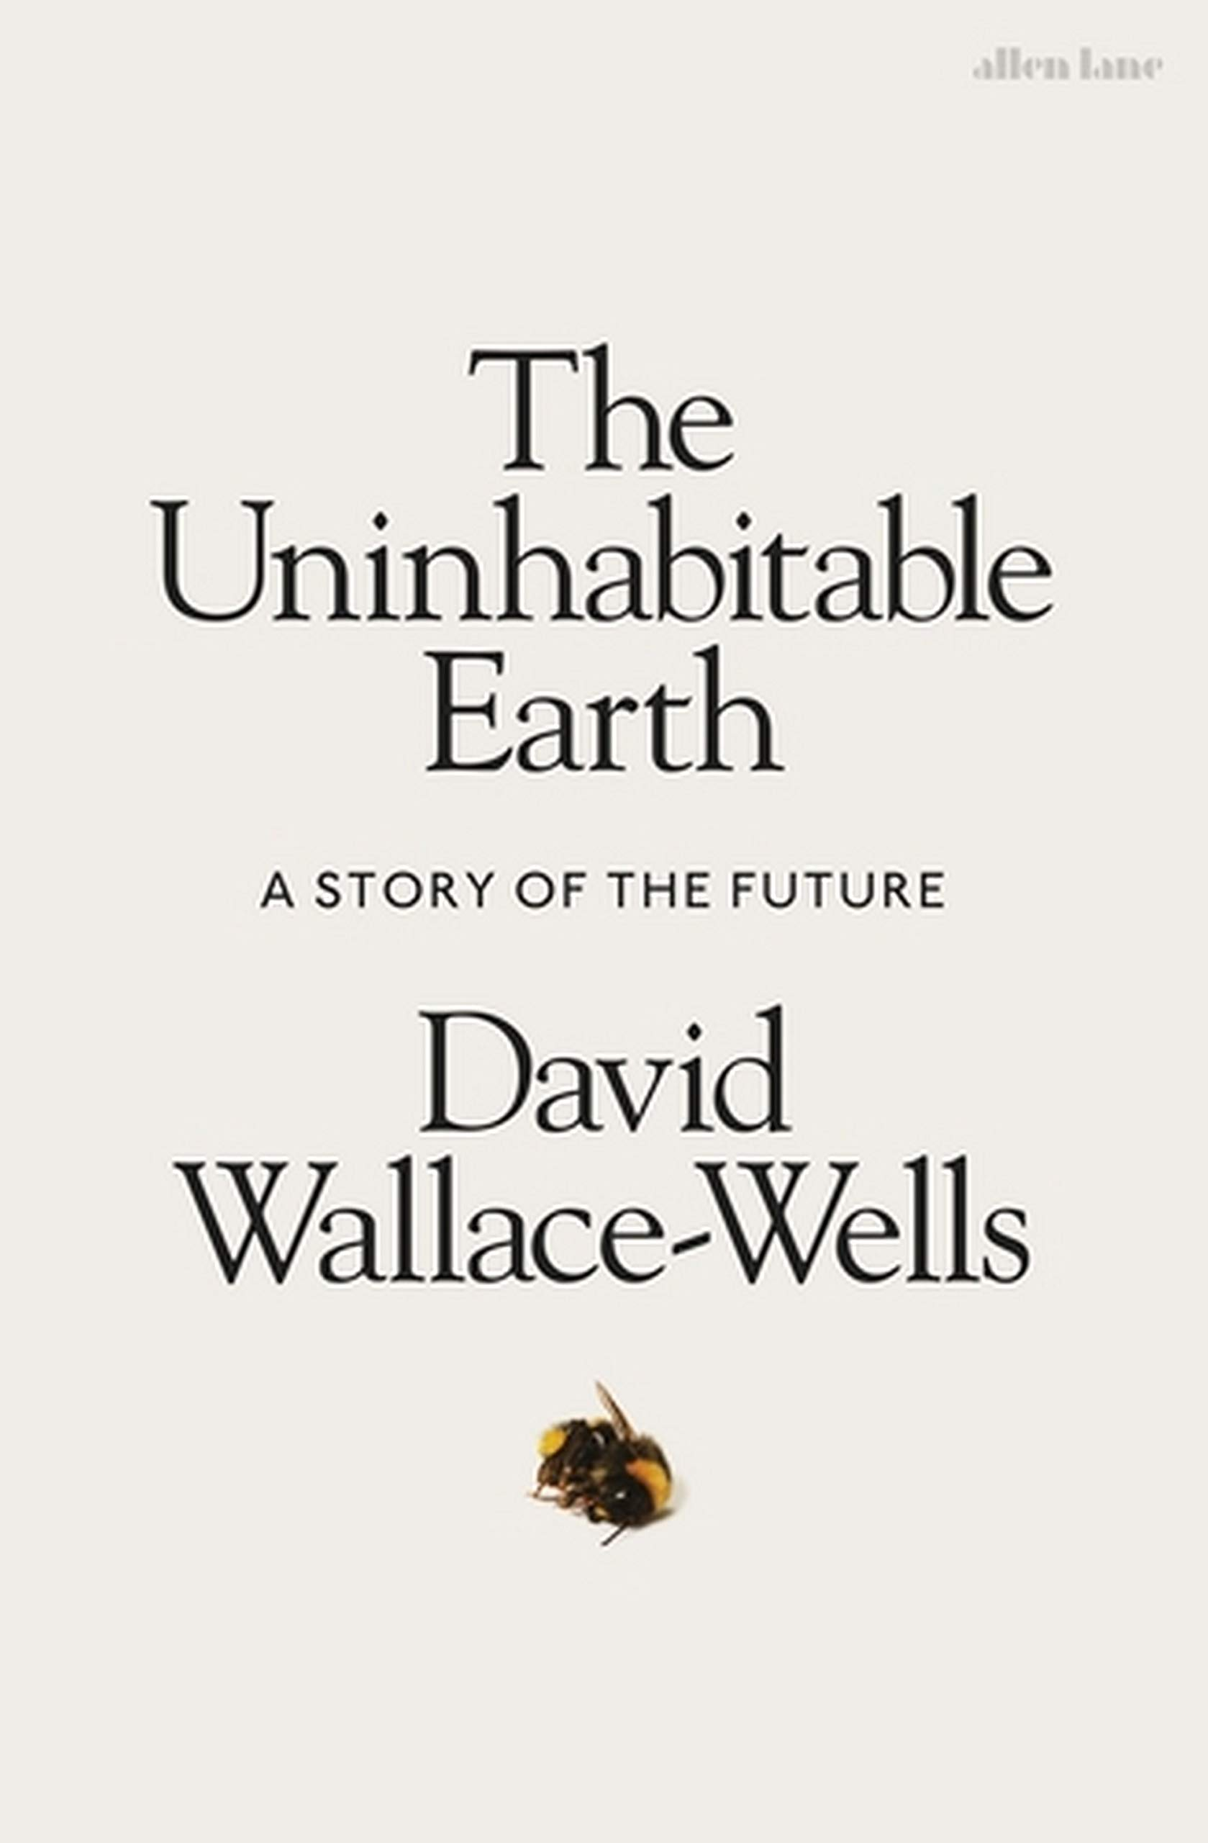
Risk and uncertainty
A central problem is that the future is unknowable—we must always estimate it
Since Knight and Keynes, economists have tended to distinguish between “risk” and “uncertainty”, as if some aspects of the future are known
In a world of risk (/uncertainty), we know (/are ignorant of) the probabilities attaching to different outcomes given initial actions (/we may not even know the range of such outcomes)
Which of these applies to environmental change?
Change equates to risk the more we understand society and its impacts on the environment; the better our reason is
Change equates to uncertainty the more speculative our social understanding and reason is
The importance of this distinction is that it allows us to see that judgements of the acceptability of risk entail judgements of what that risk consists of
Simply asserting that some risks cannot be reasonably borne (a la Wallace-Wells) is empty absent a theory of how much confidence we should have in those risks
Notes:
Is the bigger problem the unintended effects of growth, or the unintended effects of not growing? In other words, is it more acceptable to grow with the associated problems, or to avoid those problems but forgo the benefits of growth?
Note that the ethical trade-off and epistemic doubts described on this and the previous slide feed off one another. Our uncertainty in the realm of action leads to different ethical evaluations, which are related to one another as perspectival trade-offs.: We may either read our uncertainty as reason to expect action or inaction to be the more damaging thing. We can’t have it both ways, but neither option is prima facie superior.
---
The point to emphasise again is that much of the debate is not about what’s right in and of itself, but what will happen, and how this will impact upon what’s right.

Slide 6
2. Sustainability and risk
Arguments about risk are commonly conducted in terms of “sustainability”
Sustainability was adopted as an international policy goal at the U.N.’s “Earth Summit” in 1992
This view, which came to dominate policy discussions, emphasises harmony between economic, environmental and social developments
Sustainability, then, tells us to maximise value—but it doesn’t tell us how to address conflicts between values
Strong substitutability: there are some forms of “natural capital” that cannot be substituted by man-made capital
Weak substitutability: there are many ways of replacing natural capital with man made alternatives
Risks require central direction
Strong sustainability
Risks require decentralised choice
Attitudes to risk and change
Weak sustainability

Slide 7
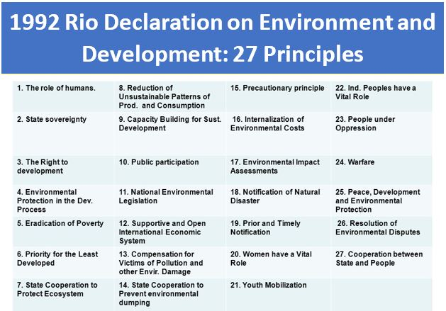
The ambiguity of sustainability
Some of these principles convey a view of reason, at least
E.g., nos. 7, 11, 14, 17, 18, 21, 23, 24
But even where it is clear that regulation is intended, what should that regulation entail?
Consider “public participation”, no. 10: Should this be participation through political or market-based mechanisms?
If democratic: is representation enough? Or is a more participatory approach needed?
If markets: socialist markets, or liberal private property?
The issue is, of course, that it’s not clear what should be sustained here, or what counts as a reasonable choice
Notes:
Environmental issues are best handled with the participation of all concerned citizens, at the relevant level. At the national level, each individual shall have appropriate access to information concerning the environment that is held by public authorities, including information on hazardous materials and activities in their communities, and the opportunity to participate in decision-making processes. States shall facilitate and encourage public awareness and participation by making information widely available. Effective access to judicial and administrative proceedings, including redress and remedy, shall be provided.

Slide 8
The precautionary principle
One important approach to environmental risk is the “precautionary principle” (PP): the principle that “you’re better safe than sorry”
If there is good reason to suspect harmful effects, we should avoid or mitigate apparently risky options
We routinely apply the PP : seat belts, cycle helmets, food safety laws, locks on doors, etc.
The PP assumes that scientific uncertainty is not a sufficient reason to avoid addressing environmental problems
The PP weights potential harms by their significance; the more important a good appears to be, the less easily we can trade it off against other goods
Inter alia, the PP has been used in environmental policy to regulate GMOs, alien species, pesticides, the use of hormones and antimicrobials in agriculture, and the use of plastics in manufacturing
The PP is the dominant principle invoked to justify climate change mitigation policies
In order to protect the environment, the precautionary approach shall be widely applied by States [sic] according to their capabilities. Where there are threats of serious or irreversible damage, lack of full scientific certainty shall not be used as a reason for postponing cost-effective measures to prevent environmental degradation.
The Rio Declaration on Environment and Development (1992) 87.

Slide 9
3. Perspectives on precaution I: The options
 | Strong PP | Weak PP
What is it? | Total forbearance in the face of significant human or environmental harm | Regulatory decisions should incorporate and consider the full range of risks even if there is no evidence of certain harm
Attitude to human action? | Action is generally assumed to be problematic unless there is categorical evidence otherwise | Action is generally assumed to be positive, though individual choices may have serious unintended consequences
Attitude to substitutability? | Environmental resources generally seen as irreplaceable; losing them risks inflicting irreversible social and ecological damage | Substitutability is largely possible, except where the loss of a certain good would be catastrophically
Notes:
Bring in science here. Have I properly situated the debate over the limits to growth relative to the PP?
Deep vs light green?

Slide 10
Perspectives on precaution II: The problems
 | Strong PP | Weak PP
Specificity | High, but implausible: since irreversibility is routine, the outcome of the strong PP is paralysis | Low: Do we all agree on what a “catastrophe” is? (Would the extinction of polar bears be catastrophic?)
Ethical appeal | Low: the strong PP implies that nature is always and everywhere good | High: Few but ideologues (or economists) would object to the idea that people are well-meaning but in some cases make bad decisions
Practicality | High in principle, but risky: Prohibiting unplanned exchanges entails foregoing the opportunity benefits of innovation | Very low: Humans struggle to apply probability values to uncertain events, so the weak PP is liable to veer towards being too strong or too weak—disagreement would likely be endemic

Slide 11
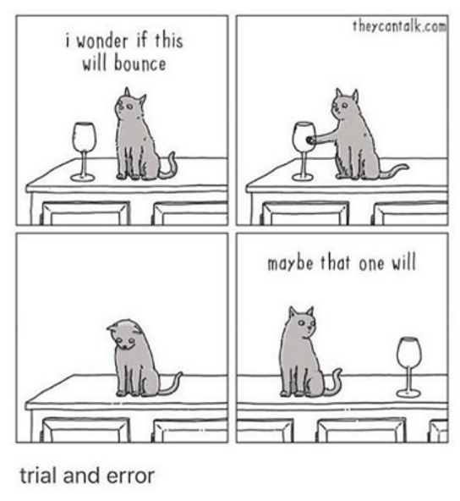
A more general objection: Can we manage risk a priori?
The strongest critique of the PP is that it is impossible to separate “risk” from “safety”; the two are necessarily intertwined
Uncertainty itself creates risk: the PP focuses on “known unknowns” to the exclusion of “unknown unknowns”
On Wildavsky’s rationalist view we increase safety by confronting and learning from risk, not avoiding it
Wealth is itself a form of safety, which we fail to obtain if we pursue caution above all else
Overall, it might be better to be robust and resilient than fragile and fearful. But of course these is an easy response here: how would we know?

Slide 12
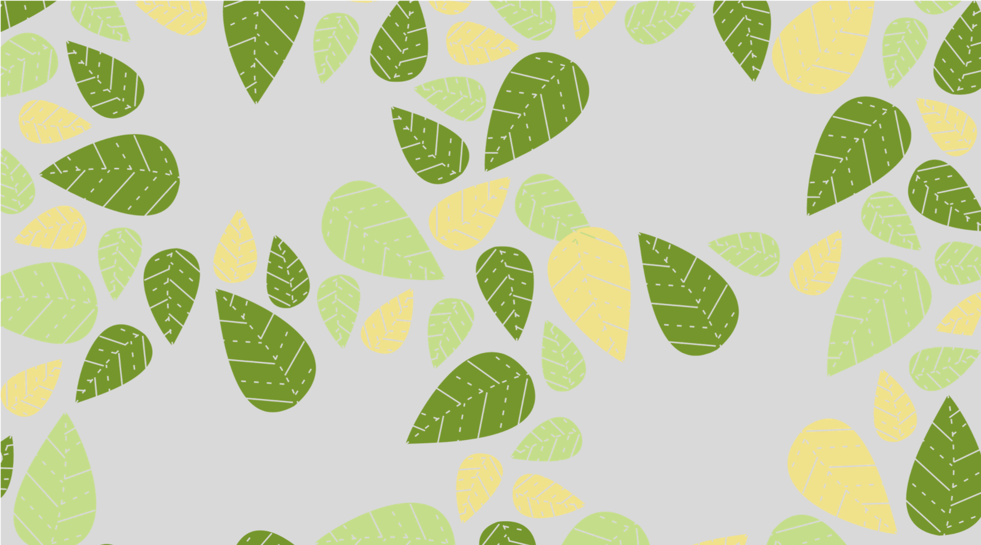
Summary
We cannot escape risk, because we face dilemmas under conditions of uncertainty
The limits debate is, in essence, a question of risk: do we risk more by allowing unregulated change, or by regulations that may be excessive or self-defeating?
But risk also allows us to clarify what’s at issue: precisely what values matter, and how are they related (i.e., the question of substitutability)? To what extent is it acceptable to externalise costs onto nature?
Crucially, this all means that the tendency to caution is not automatically a solution to the limits debate
The PP may fail its own test (a la Sunstein and Wildavsky): it may create catastrophes rather than avoid them [call this the n = 1 question]
The PP may be more interesting, however, as a social-cultural phenomenon: why do we focus on some risks rather than others? [call this the n = many question]
Who gets to decide which risks are going to be addressed? Who gets to decide which conception of “nature” to protect?
What are the ethics of environmental protection? What is reason, and how (when) is it valid?
Notes:
We cannot escape risk, because we face dilemmas under conditions of uncertainty
The limits debate is, in essence, a question of risk: do we risk more by allowing unregulated change (which may overshoot limits), or by excessive or self-defeating regulation (which may undermine our ability to protect our values)?
But risk also allows us to clarify what’s at issue: precisely what values matter, and how are they related (i.e., the question of substitutability)? To what extent is it acceptable to externalise costs onto nature (e.g., to cut down trees to allow local development)?
Crucially, this all means that the tendency to caution is not automatically a solution to the limits debate
The PP may fail its own test (a la Sunstein and Wildavsky): it may create catastrophes rather than avoid them [call this the n = 1 question]
The PP may be more interesting, however, as a social-cultural phenomenon: why do we focus on some risks rather than others? [call this the n = many question]
Who gets to decide which risks are going to be addressed? Who gets to decide which conception of “nature” to protect?
What are the ethics of environmental protection? What is reason, and how [when] is it valid?

